Slide 1
Polarimetric ISAR Space Target Recognition and Detection
Nischala G.S
Under the Guidance Of
Faheemah A.G.J

Slide 2
Problem Statement
The main problem is fine recognition of space targets from polarimetric ISAR images. Since satellite ISAR images contain structure-sensitive scattering information, the objective is not only to classify the target but also to identify and localize important components such as body parts, antennas, solar arrays, fittings and optical lenses.
Main research question: can polarimetric fusion improve component-level OBB detection over a strong single-polarization baseline?
To develop and evaluate robust learning-based methods for polarimetric ISAR space target fine recognition and component-level oriented object detection by using magnitude, phase and full-polarimetric fusion information from HH, HV, VH and VV channels.

Slide 3
Primary Dataset: Pol-ISARSpaceTarget-1.0
The main dataset used in the project is Pol-ISARSpaceTarget-1.0. it is a polarimetric ISAR electromagnetic simulation dataset for space target fine recognition. It provides full-polarimetric complex data, amplitude TIFF images, Pauli images and component annotations.
Item | Verified / Reported Detail
Satellite target types | 6
Polarization channels | HH, HV, VH, VV
Image size | 256 x 256 after processing
Complex DAT files | 13104
Annotation files | 1638
Component instances | 16577
Object classes | 9 component classes

Slide 4
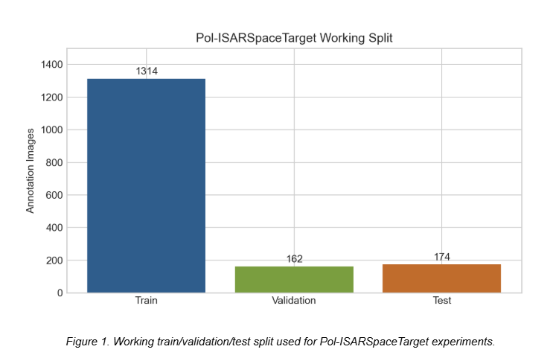
Contd..
The 9 component-level object classes are:
1. cuboid_body
2. optical_lens
3. panel_antenna
4. parabolic_antenna
5. plate_body
6. plate_fitting
7. polygon_body
8. rod_fitting
9. solar_array
The dataset folder contains:
1. Annotations
2. TIFFImages
3. ImageSets
4. Tools
Important subfolders:
ImageSets/images/train, valid, test:Complex DAT files for HH, HV, VH and VV channels.
ImageSets/labelTxt/train, valid, test:DOTA-style oriented bounding box labels.
TIFFImages/AmplitudeImages:Amplitude TIFF images for each polarization.
TIFFImages/PauliImages:Provided Pauli pseudo-colour images.
Tools:Python and MATLAB read scripts for the complex DAT data.

Slide 5
Initial Study Topics
1. ISAR image formation
2. Magnitude-based feature extraction
3. Phase-based feature extraction
4. Polarimetric ISAR interpretation
5. Robust ISAR classification via feature fusion
6. Difference between real-valued CNN and complex-valued CNN

Slide 6
Classification Work
The initial classification objective was to classify the satellite target using polarimetric ISAR data.
Main classification methods studied:
1. Magnitude-only features
2. Phase-only features
3. Magnitude + phase feature fusion
4. Complex CNN
5. ResNet18 magnitude-only baseline
6. Statistical feature classifiers
7. Feature selection using statistical and attention-based methods

Slide 7
Complex CNN
A Complex CNN was implemented to process complex-valued polarimetric data. The idea was to preserve both real and imaginary information rather than discarding phase by using magnitude-only images.
Core principle: For a complex input x = a + jb and complex convolution weights W = Wr + jWi, the complex convolution is:
Real output = Wr(a) - Wi(b)
Imaginary output = Wr(b) + Wi(a)
The implemented architecture included:
1. Complex convolution layers
2. Complex batch normalization
3. Complex activation
4. Residual blocks
5. Feature extraction from higher layers
6. Final classification head

Slide 8
Magnitude and Phase Feature Extraction
For each full-polarimetric image, features were extracted from: HH, HV, VH and VV
Magnitude = sqrt(real^2 + imaginary^2)
Phase = atan2(imaginary, real)
The feature vector was formed using: [mag_HH, mag_HV, mag_VH, mag_VV, phase_HH, phase_HV, phase_VH, phase_VV]
In one feature study, each channel was resized/downsampled to 64 x 64 before flattening. Therefore, each image was represented using 32768 feature values.
Feature matrices created:
Train: 1314 x 32768
Validation: 162 x 32768
Test: 162 x 32768 in that specific notebook run

Slide 9
Magnitude & Phase Range Check
Before normalization, magnitude and phase ranges were checked.
Observed sampled range:
Magnitude minimum: 2.4063e-05
Magnitude maximum: 311.7235
Phase minimum: -3.14159 radians
Phase maximum: 3.14159 radians
Observation:Phase was within the expected range of approximately -pi to +pi. Magnitude had a much wider dynamic range, so different normalization strategies were tested.

Slide 10
Normalization & Leakage Correction
All normalization statistics were computed only from the training data. The same training statistics were then applied to validation and test data.
Statistics computed from the training matrix:
1. Mean
2. Variance
3. Standard deviation
4. Minimum
5. Maximum
6. Median
7. Interquartile range
8. Maximum absolute value

Slide 11
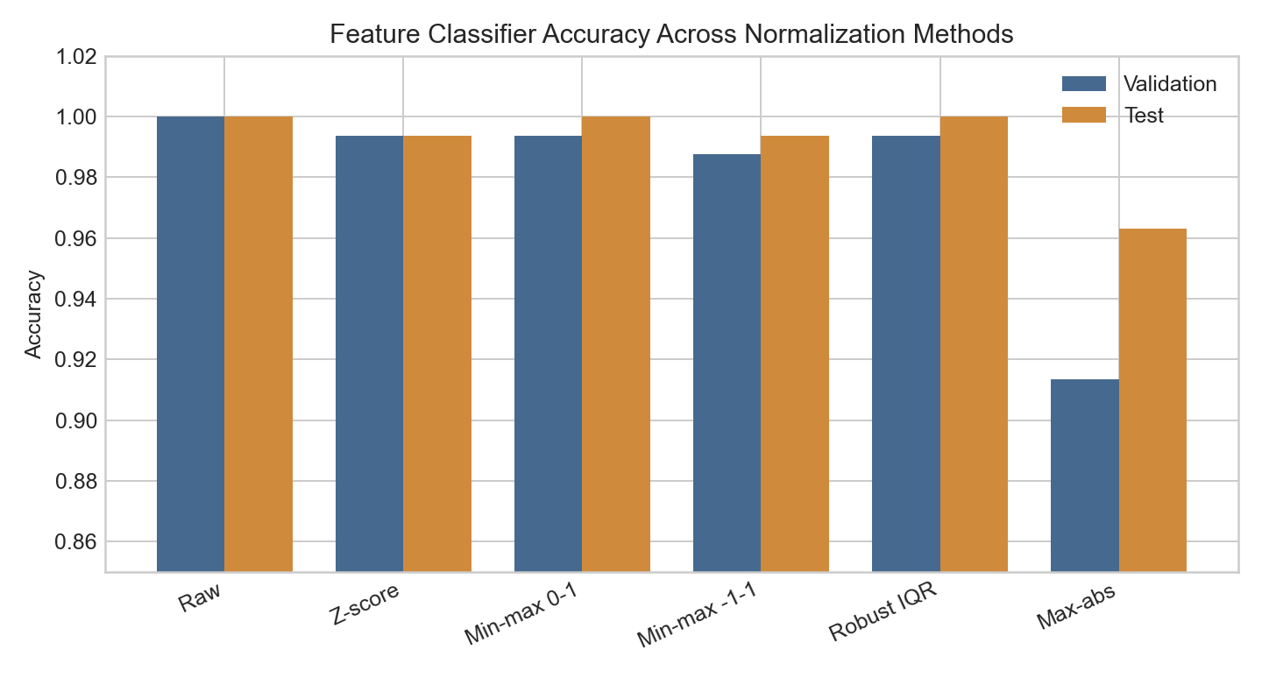
Contd...
Normalization | Validation Accuracy | Test Accuracy
Raw / none | 1.0000 | 1.0000
Standard z-score | 0.9938 | 0.9938
Min-max 0 to 1 | 0.9938 | 1.0000
Min-max -1 to 1 | 0.9877 | 0.9938
Robust IQR | 0.9938 | 1.0000
Max-absolute | 0.9136 | 0.9630
The extracted magnitude + phase feature matrix appears highly separable under the official split. Since even raw features produced very high accuracy, these results were treated cautiously. The high values may indicate that the official split is easy or that samples are strongly class-separable by target/view conditions. Therefore, stronger validation is needed before claiming robust gen

Slide 12
ResNet 18
A ResNet18 magnitude-only baseline was implemented to compare normal CNN behavior against complex/polarimetric feature approaches.
Setup:
1. Input: 4-channel magnitude only
2. No phase used
3. No complex-valued arithmetic
4. First ResNet18 convolution modified for 4-channel input
5. Magnitude mean and standard deviation computed from training data only
6. Same statistics applied to validation and test
7. Training augmentation applied only to the training set

Slide 13
Contd...
Observed result from one run:
Test accuracy: 0.4136
Test macro-F1: 0.3805
Interpretation:The ResNet18 model showed weak generalization in that run. This suggests that a normal CNN on magnitude-only data is not automatically sufficient. However, the result should be treated as an initial baseline and should be repeated using best-validation checkpoint selection and improved regularization.

Slide 14
Feature Selection Work
Feature selection was added after guide feedback.
Methods included:
1. Statistical feature selection
2. ANOVA-F based feature selection
3. Attention-based feature selection
Purpose: To identify whether all extracted magnitude/phase features are required or whether a reduced feature subset can preserve classification performance.
Interpretation:Because some feature-classifier results already reached near-perfect performance, feature selection is not necessarily required for improving accuracy on the official split. Its value is more in interpretability, dimensionality reduction and robustness checks.

Slide 15
Dataset 2: TFPSSTD ISAR Dataset
The second dataset studied was the TFPSSTD dataset from IEEE DataPort.
Dataset classes:
1. Satellite I 2. Satellite II 3. Satellite III
Files downloaded: Satellite I, Satellite II and Satellite III ZIP files were downloaded/extracted.
Observed files:
393 MAT files
Total extracted MAT size approximately 14.6 GB
Each MAT file contains full-polarimetric complex ISAR images.
Important fields observed:
1. ISAR_FullPol_DualADMM
2. ISAR_FullPol_PFA
3. para metadata containing range, crossrange, fc and B

Slide 16
RAM-Safe Pipeline
ISAR_FullPol_DualADMM was selected as the main input for the first classification experiment because the dataset description mentions the low-sidelobe Dual-ADMM imaging method.
The TFPSSTD dataset caused Colab RAM issues due to large MAT files.
RAM-safe corrections:
1. Load one MAT file at a time.
2. Use only the required ISAR field.
3. Convert complex128 to complex64.
4. Convert shape from 601 x 601 x 4 to 4 x 601 x 601.
5. Resize CNN input to 128 x 128.
6. Use small batch size.
7. Avoid loading all files into memory at once.

Slide 17
Classification Pipeline
Implemented components:
1. View-disjoint train/test split using AccAngle and StaAngle.
2. Magnitude and phase vector extraction.
3. RCS-like feature computation.
4. Train-only normalization statistics.
5. Classifiers: SGD logistic classifier, Linear SVM and Random Forest.
6. Feature selection using ANOVA-F.
7. ResNet18 magnitude-only image classifier.
8. Complex-input CNN using 8 channels: real and imaginary parts of HH, HV, VH and VV.

Slide 18
RCS Feature Work
The guide asked to compute RCS from ISAR images.
Implemented idea: RCS-like features were computed from the ISAR magnitude/scattering intensity.
The purpose was to summarize target scattering energy and compare whether physically meaningful radar features support classification.
Possible RCS-like statistics:
1. Total scattering energy
2. Mean intensity
3. Peak intensity
4. Channel-wise energy
5. Polarimetric ratios
6. Energy distribution across range/cross-range regions

Slide 19
Object Detection
The project moved from classification to object detection because Pol-ISARSpaceTarget provides component-level oriented bounding box labels. The original DOTA-style labels were converted into Ultralytics YOLO-OBB format by normalizing the four corner coordinates to the 0 to 1 range.
The dataset provides oriented bounding boxes for components. Therefore, object detection is more aligned with the annotation richness of the dataset than only image-level classification.
Localize and classify satellite components in ISAR images using oriented bounding boxes.

Slide 20
Object Detection Pipeline
The DOTA-style labels were converted into Ultralytics YOLO-OBB format.
Original DOTA-style format: x1 y1 x2 y2 x3 y3 x4 y4 class difficult
YOLO-OBB format: class x1 y1 x2 y2 x3 y3 x4 y4
The coordinates were normalized to the 0 to 1 range.
Three input representations were compared for YOLO11n-OBB detection: single VV amplitude, fixed Pauli fusion and learned fusion. Single VV served as the strong single-polarization baseline. Pauli fusion used physically meaningful polarimetric combinations. Learned fusion used real and imaginary channels from HH, HV, VH and VV to produce a 3-channel detector input.

Slide 21
Detection Inputs Compared
Three input representations were compared:
1. Single-VV baseline
Input:VV amplitude image.
Reason:VV is a standard single-polarization baseline and performed strongly.
2. Fixed Pauli fusion
Input generated from full-polarimetric channels:
R = |HH - VV|
G = |HV + VH|
B = |HH + VV|
Reason:Pauli decomposition is physically meaningful and uses polarimetric information.
3. Learned fusion
Input:HH, HV, VH and VV complex data represented as real and imaginary channels.
Method:A small learnable fusion stem mapped 8 input channels to a 3-channel image, which was then used by YOLO-OBB.

Slide 22
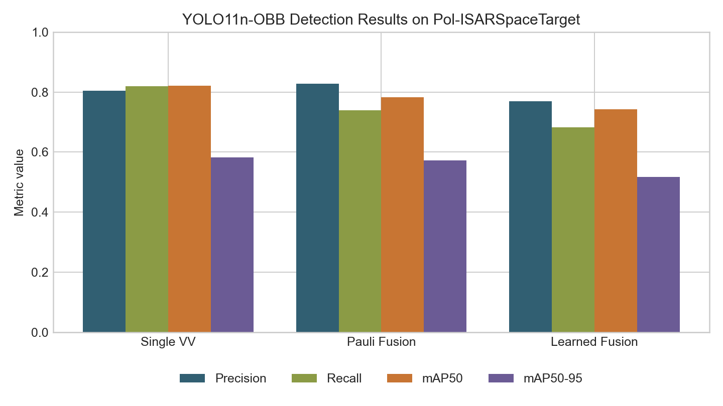
Detection Results
Input Representation | Precision | Recall | mAP50 | mAP50-95
Single VV | 0.804 | 0.819 | 0.821 | 0.582
Pauli Fusion | 0.828 | 0.739 | 0.783 | 0.573
Learned Fusion | 0.770 | 0.683 | 0.743 | 0.518
The strongest completed detection result so far is YOLO11n-OBB using the single VV amplitude image. Pauli fusion gave slightly higher precision but lower recall and lower overall mAP. The first learned-fusion approach did not improve performance. This result is important because it shows that simply adding polarimetric channels is not enough; the fusion method needs to be optimized for detection.

Slide 23
Non Yolo-OBB Detector Experiments
Two pure PyTorch diagnostic baselines were implemented:
1. CenterNet-OBB
2. DETR-OBB-Lite
Observed results:
CenterNet-OBB:
Precision: 0.0636
Recall: 0.1074
F1 score: 0.0799
DETR-OBB-Lite:
Precision: 0.0835
Recall: 0.0958
F1 score: 0.0892
Interpretation:
These simple baselines performed poorly compared with YOLO-OBB. They are useful only as diagnostic non-YOLO baselines, not as final methods.

Slide 24
MMRotate / SOTA OBB Methods Considered
The following stronger non-YOLO OBB methods were identified:
1. Rotated RetinaNet
2. Rotated Faster R-CNN
3. RoI Transformer
4. Oriented R-CNN
Issue: These methods are commonly available through MMRotate/OpenMMLab. The Colab Python 3.12 environment caused dependency failures with mmcv/mmrotate. Therefore, these methods should be run in a Python 3.10 conda environment or a compatible cloud runtime

Slide 25
Current Work
The most useful finding so far is that single VV is a strong detection baseline on the current split. The polarimetric inputs are physically meaningful, but the fixed and simple learned fusion approaches did not outperform the VV baseline. This gives a clear research direction: the fusion should happen inside the detection network and should be optimized using the oriented detection loss, instead of only generating a fused image before training.
The YOLO-OBB training was updated to increase the number of epochs.
Current long-run setup:
Models: 1. YOLO11n-OBB 2. YOLO11s-OBB
Input: single_vv
Training:
Maximum epochs: 100
Early stopping patience: 25
Checkpoint save period: every epoch
Resume support: enabled from last.pt
Reason:Earlier YOLO runs gave the best performance, so the current priority is to strengthen the YOLO baseline with longer training and proper checkpoint recovery before adding further complexity.

Slide 26
Chinese Paper Study
The Chinese paper attached is the Pol-ISARSpaceTarget-1.0 dataset paper from Journal of Signal Processing.
Key points extracted so far:
1. The paper introduces Pol-ISARSpaceTarget-1.0 as a public polarimetric ISAR dataset for space target fine recognition.
2. The dataset contains 6 satellite targets and 9 component categories.
3. The data was generated through electromagnetic simulation and ISAR imaging.
4. The authors provide full-polarimetric complex data, amplitude images, Pauli images and component annotations.
5. The paper includes dataset construction, electromagnetic simulation, imaging processing, annotation workflow and baseline recognition experiments.
Next step: Translate the full paper section-wise into English and identify:
1. Models used by the authors.
2. Dataset split protocol.
3. Baseline metrics.
4. Limitations of their work.
5. Research gap for our paper.

Slide 27
Planned Augmentation Work
To apply augmentation using imgaug or a similar library.
Planned augmentation:
1. Small rotation
2. Horizontal/vertical flip where physically valid
3. Translation
4. Scaling
5. Gaussian noise
6. Speckle-like noise
7. Contrast variation
Important condition:For object detection, augmentation must transform the oriented bounding boxes along with the image. Therefore, the augmentation library must support keypoints/polygons or bounding box coordinate transformation.

Slide 28
Proposed Novel Method Detection
The main gap observed from experiments is:Simple polarimetric image fusion does not outperform the single VV YOLO-OBB baseline. Therefore, a stronger method should perform detection-aware polarimetric fusion inside the model rather than generating a fixed fused image before detection.
Proposed method idea: Detection-Aware Polarimetric Fusion YOLO-OBB
Core idea:
1. Use HH, HV, VH and VV complex inputs.
2. Represent each channel using magnitude, phase or real/imaginary components.
3. Use separate shallow branches for co-pol and cross-pol information.
4. Apply channel attention and spatial attention to learn which polarization channels help each component.
5. Fuse features inside the detector backbone.
6. Train the full model using oriented detection loss.
Expected contribution:Instead of using fixed Pauli fusion or image-level learned fusion, the proposed method lets the detector learn polarimetric importance directly for component localization and classification.

Slide 29
Next Steps
Complete the 100-epoch YOLO11n-OBB and YOLO11s-OBB runs and compare training curves.
Add imgaug-based augmentation with correct polygon transformation for OBB labels.
Translate the Chinese paper fully and extract the author model details and reported benchmarks.
Use the larger version of the YOLO model and compare the training curves.
Run Rotated RetinaNet, Rotated Faster R-CNN, RoI Transformer and Oriented R-CNN in a Python 3.10/MMRotate environment.
Develop and test a detection-aware polarimetric fusion model using HH, HV, VH and VV complex data.
Begin paper drafting around the gap: polarimetric fusion for component-level oriented detection in ISAR imagery.

Slide 30
Proposed Paper & References
Possible paper title: Detection-Aware Polarimetric Feature Fusion for Component-Level Recognition in ISAR Space Target Images
Possible contributions:
1. A systematic study of magnitude, phase and polarimetric fusion representations for ISAR space target recognition.
2. A strong YOLO-OBB baseline for component-level detection on Pol-ISARSpaceTarget-1.0.
3. A comparison of single-polarization, Pauli-fusion and learned-fusion inputs.
4. A proposed detection-aware polarimetric fusion architecture.
5. Robustness and ablation analysis using normalization, augmentation, view-based splits and cross-dataset testing.
References
Chen Siwei, Li Mingdian, Cui Xingchao. Pol-ISARSpaceTarget-1.0: Polarimetric ISAR Electromagnetic Simulation Dataset for Space Target Fine Recognition. Journal of Signal Processing, 2025.
Ultralytics YOLO-OBB documentation and project experiment notebooks.
Conclusion
The work has progressed from dataset understanding and classification experiments to component-level oriented object detection. The strongest completed result is YOLO11n-OBB on single VV amplitude images, with precision 0.804, recall 0.819, mAP50 0.821 and mAP50-95 0.582. The main open question is how to use the full polarimetric complex information in a way that improves detection rather than only adding more input channels. This forms the basis for the next experimental phase and the possible paper contribution.

